Slide 1
CampfireAnalytics Case Study
by Andy Chen

Slide 2
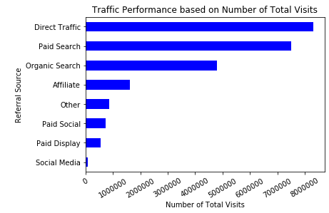
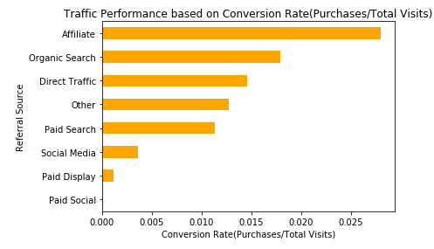
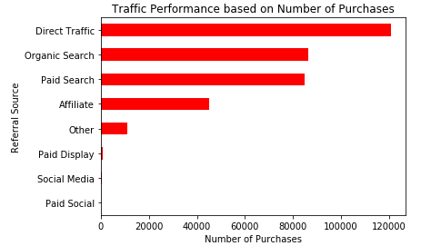
1. Which traffic sources perform best, and why?
Answer: Affiliate
Affiliate has the best performance because Affiliate has the
highest Conversion Rate(Purchases/Total Visits), even though
Direct Traffic has the highest number of Total Visits and the
highest number of Purchases. We need to focus on Conversion
Rate which means efficiency, so we can invest more in
Affiliate Marketing.

Slide 3
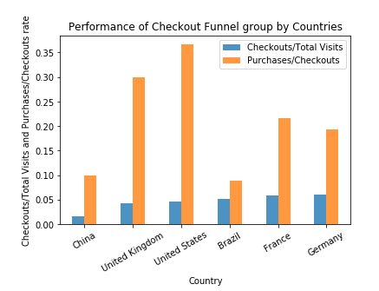
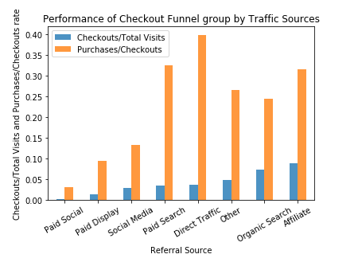
2. Do there appear to be checkout funnel issues for any particular countries or traffic sources? Please explain.
Answer: Paid Social, China.
Paid Social has checkout funnel issues, because its rate of 'Checkouts/Total Visits' and 'Purchases/Checkouts' are
all lowest, which means very few percent of visitors from paid social go to checkouts and very few percent of visitors
from paid social in checkouts will complete a purchase. The same reason for China.

Slide 4
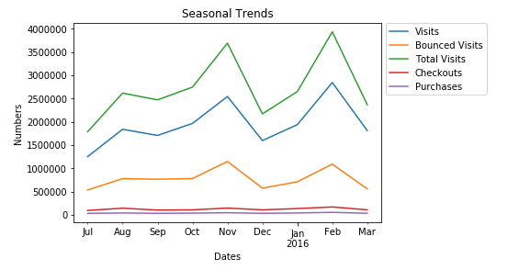
3. Do there appear to be any seasonal trends that we should be aware of?
Answer: Yes.
The number of total visits has a dramatically decrease in November and February, but an
increase in July, October, December and January.

Slide 5
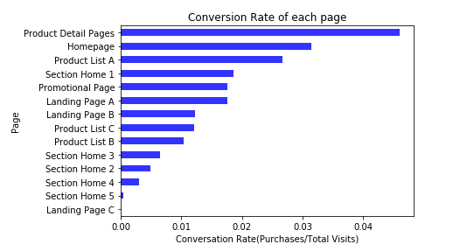
4. Which pages are most effective, and why?
Answer: Product detail pages, Homepages and Product List A
Because their conversion rate are the highest. That means they are more effective to convert their
visitors to purchasers.

Slide 6
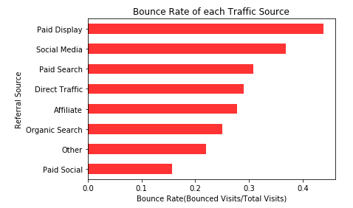
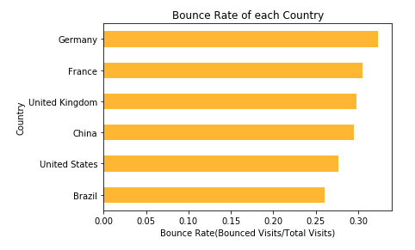
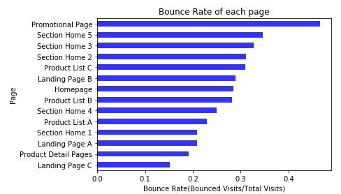
5. What else can you tell us from this data that may help inform future business decisions or optimizations?
Promotional Page in all the pages has the highest Bounce Rate.
Paid Display in all traffic sources has the highest Bounce Rate.
And the Bounce Rate is highest in Germany.

Slide 7
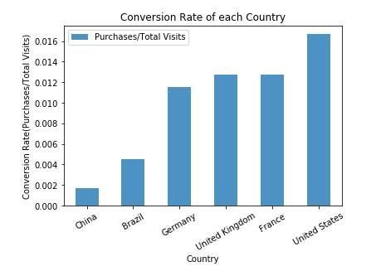
Conversion Rate in highest in United States.

Slide 8
Thank you!

